Slide 1
CS4287/5287: Cloud Computing
Fall 2020
Vanderbilt University
Dept of Electrical Eng & Comp Sc
Instructor: Aniruddha (Andy) Gokhale
a.gokhale@vanderbilt.edu
http://www.dre.vanderbilt.edu/~gokhale
Scaffolding for Assignment #1

Slide 2
Motivation for this Slide Deck
Describes a basic setup to test solution locally but using VMs
Scenario
Demo comprises a Kafka setup and connector to database
My demo setup includes 2 Virtualbox VMs created on my laptop (one Ubuntu 18.04 and one Ubuntu 20.04)
Your assignment will include VM on laptop serving as the client/generator of events, and VMs on the cloud
Demo
Command line demo
Kafka Python streaming API for programmatic approach

Slide 3
My Setup
VM1 = Ubuntu 18.04
IP Address: 192.168.5.2 on the NAT network and 192.168.56.102 on the Host-only network
Will run one of two Kafka servers (Broker ID = 0)
Will run the producer of events using Kafka Python streaming
Will run command line consumer
VM2 = Ubuntu 20.04
IP Address: 192.168.5.3 on the NAT network and 192.168.56.103 on the Host-only network
Will run the zookeeper server
Will run one of the two Kafka servers (Broker ID = 1)
Will use to create our “utilization” topic
Will run our external consumer (e.g., programmatic, DB, etc)
From each VM, make sure you can ping the other VM on both its IP addresses

Slide 4
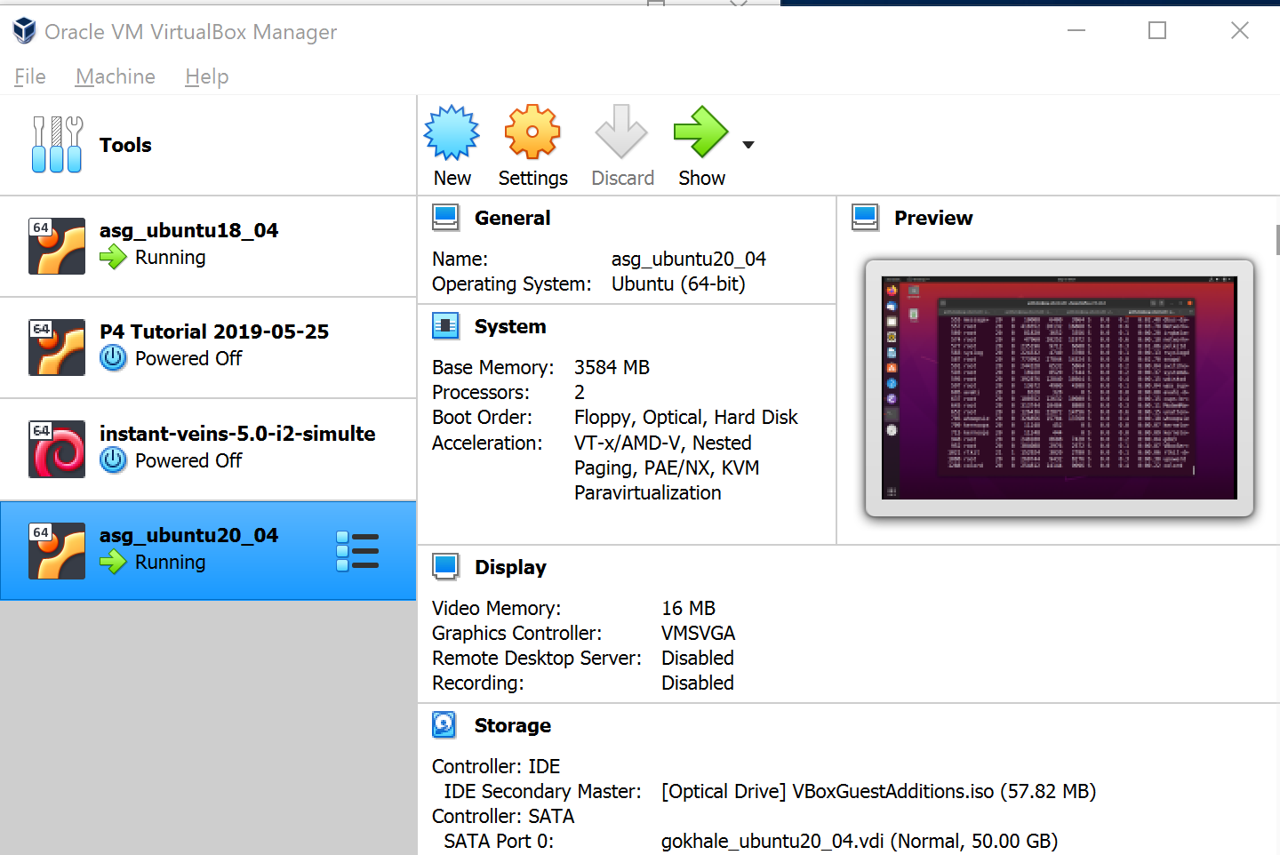
Two Local VMs on My VirtualBox

Slide 5
VBoxManage Command Line Program
Your VirtualBox installation will come with a management utility called VBoxManage, which is a command line program
On Windows, you invoke it in a command shell; on Linux/MAC, you run it in a shell (e.g., bash shell)
If the executable is not in your PATH environment variable, you will have to use the full executable to the VBoxManage program
This command is a low-level, non-UI but extremely powerful utility to configure and manipulate many different aspects of the VirtualBox environment
See https://www.virtualbox.org/manual/UserManual.html#vboxmanage for more details

Slide 6
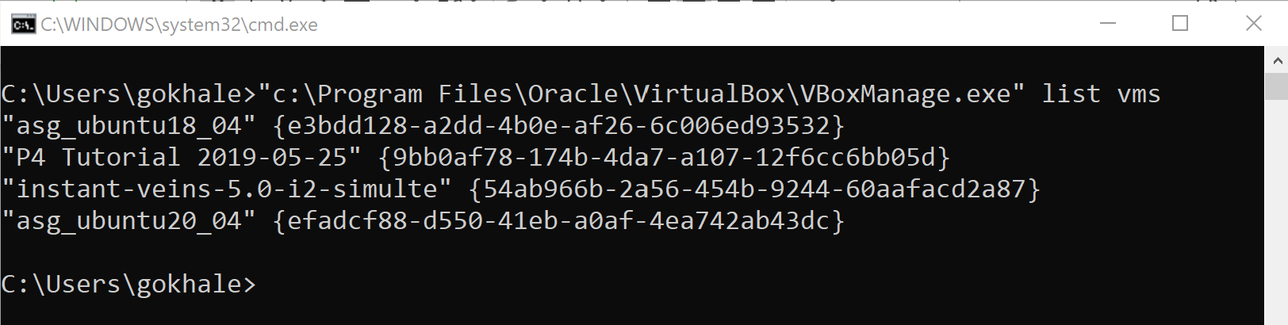
Listing VMs using VBoxManage
See how I had to use the absolute path to the executable
We can use either the VM name or its GUID when manipulating its properties

Slide 7
VirtualBox’s NAT Network Feature
The simplest network adapter that the VM can use is the NAT (network address translation)
NAT allows traffic from the VM to go outside and receive responses over the current outgoing connection (i.e., you can visit sites and download software)
However, outside traffic cannot get in as the virtual router makes the internal network private, i.e., you cannot deploy a server and make it available to the outside world
One way to overcome this is via port forwarding but we will not use it in this setup
The NAT Network adapter is similar to NAT except that multiple VMs connected on the same NAT Network can communicate with each other which is not possible with plain NAT
Since we plan to create two VMs on our laptop and have them talk to each other, we will create a NAT Network

Slide 8
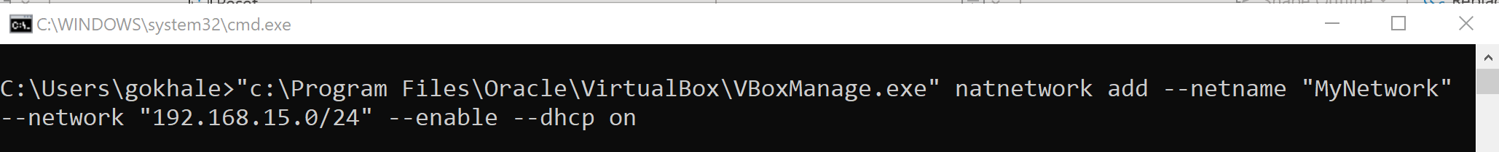
Creating and Assigning a NAT Network to VM
We will use the VBoxManage command line executable to create the NAT network
We will enable DHCP for our network
Subnet mask for the MyNetwork NAT

Slide 9
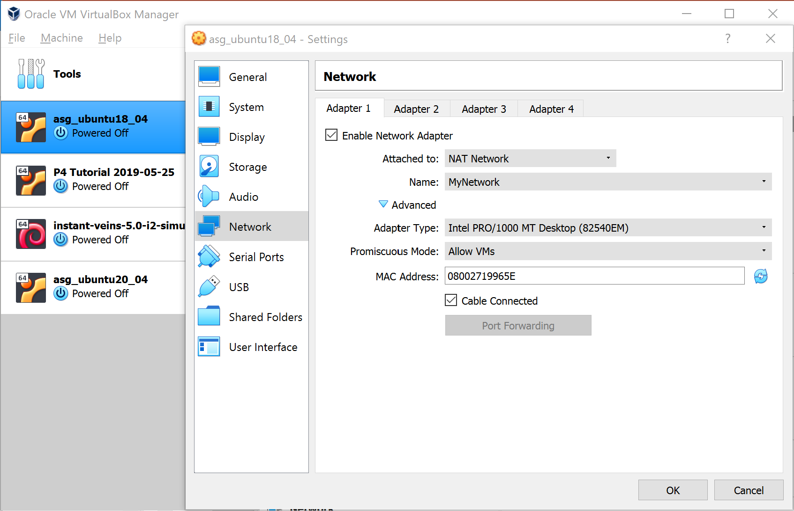
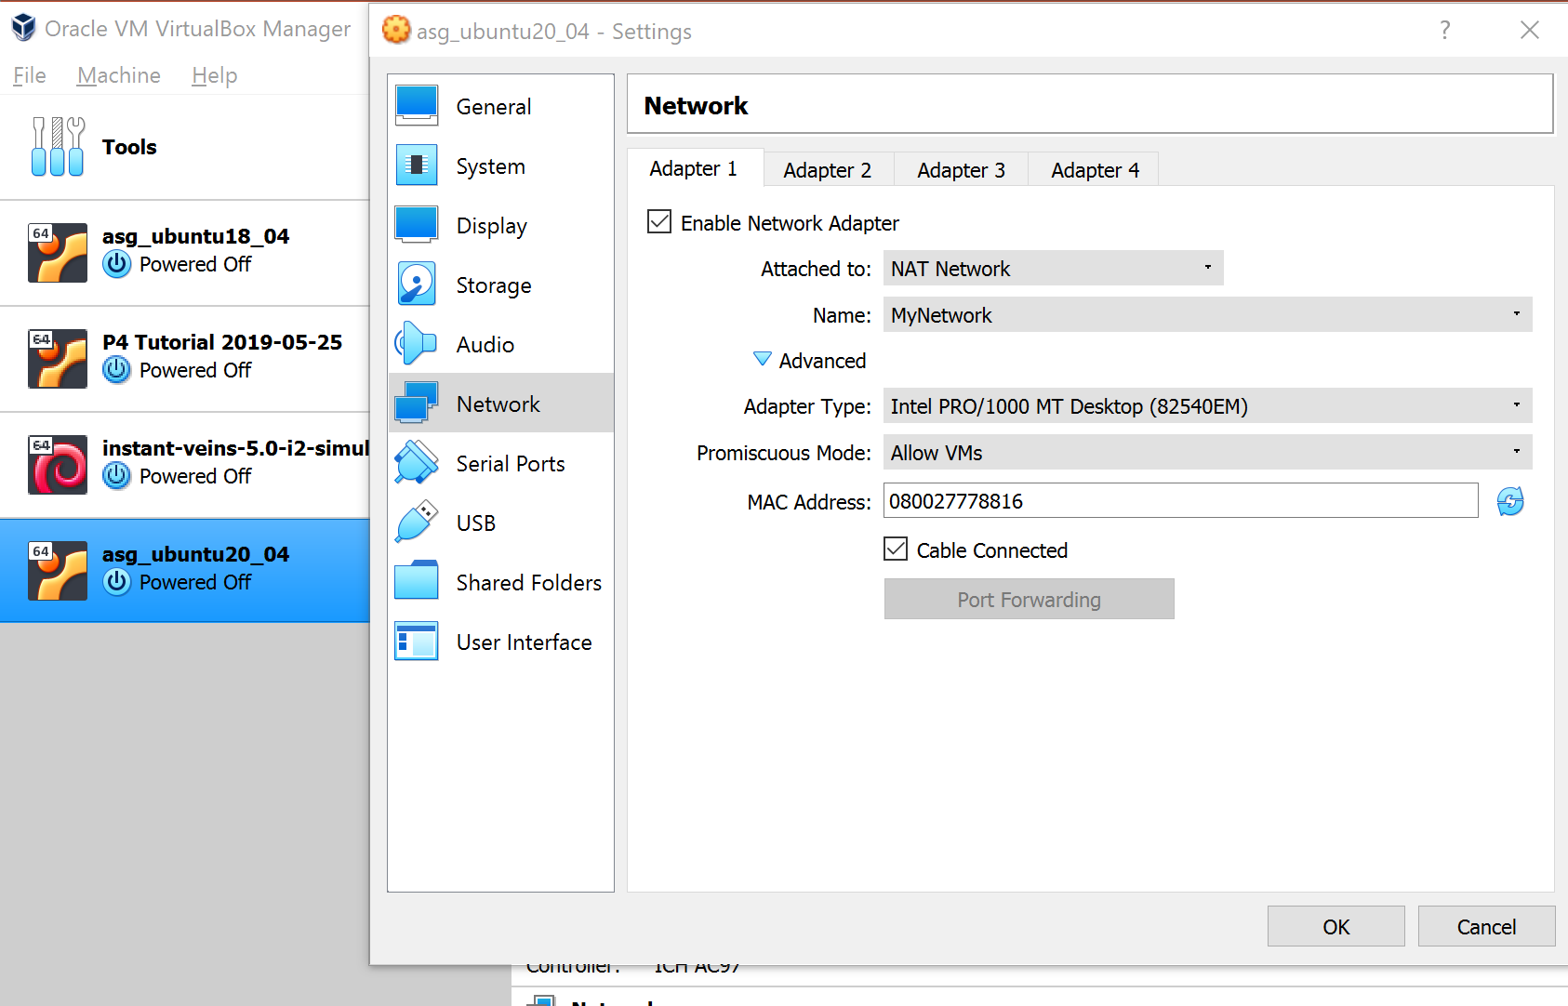
Adding NAT Network Adapters to VMs
Both the VMs use the MyNetwork NAT network that we just created
In the advanced tab, I selected “Allow VMs” in the promiscuous mode, which will allow them to communicate with each other but nothing else

Slide 10
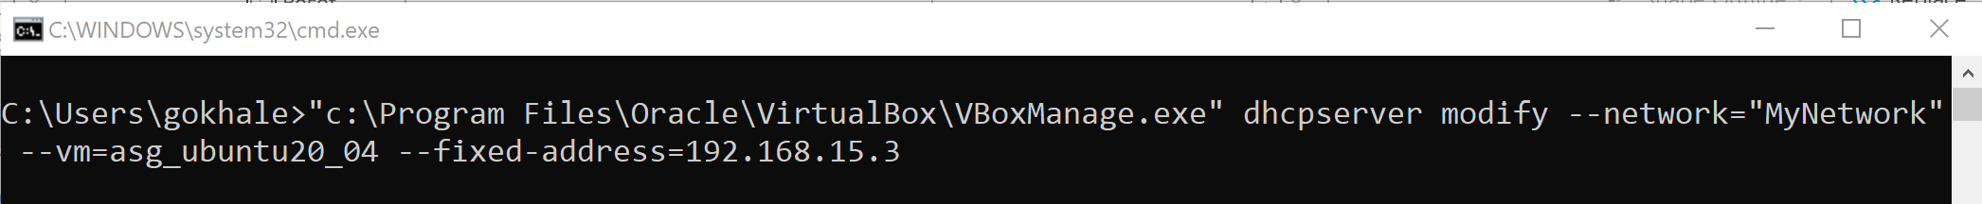
Adding Fixed IP Address to VMs on NAT Network
We will assign fixed IP addresses to our VMs so that they don’t keep changing their IP addresses every time they boot up
DHCP will always assign this IP to this VM
I assigned 192.168.15.2 to VM1 and 192.168.15.3 to VM2

Slide 11
Use of VirtualBox Host-Only Network
Another way for VMs on the same host to talk to each other is if they are part of the same “Host-only Network”
This allows internal communication within the host only
No communication to the outside world is possible using the Host-only Network
We will also create a Host-only Network and have our VMs be part of that network also

Slide 12
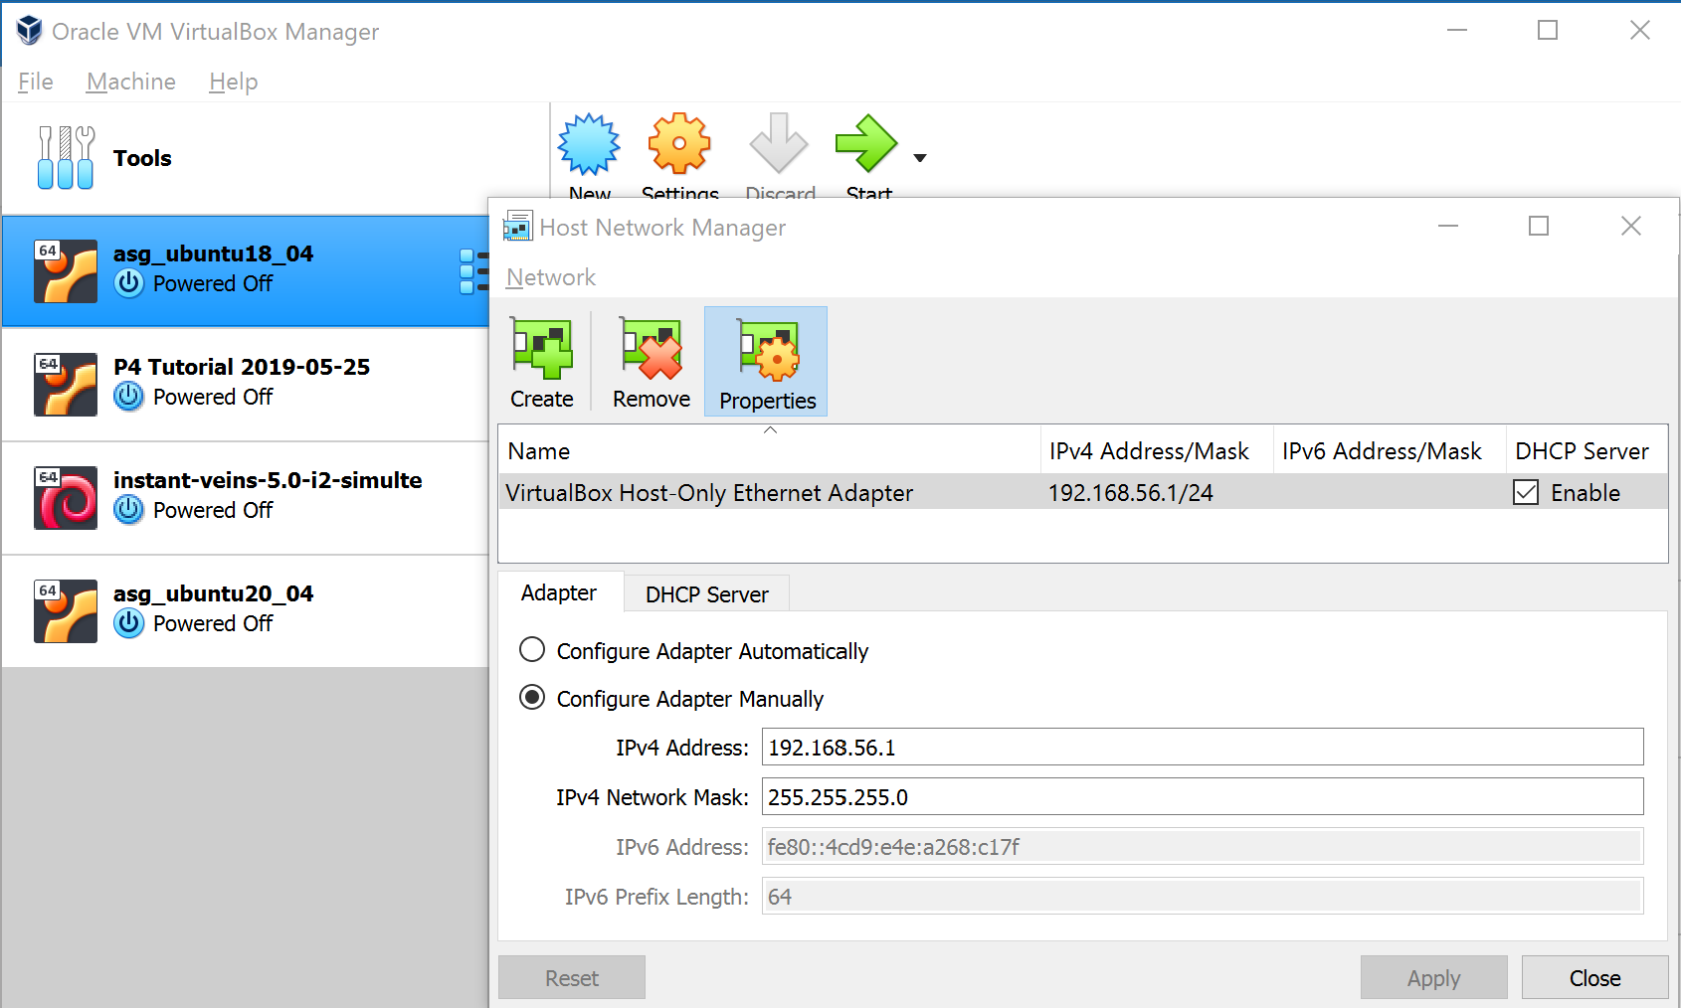
Creating Host-Only Network from GUI
From the File menu, select Host Network Manager, and press Create
Then choose Properties and enable DHCP and set the network mask as shown
You can create this via VBoxManage command also

Slide 13
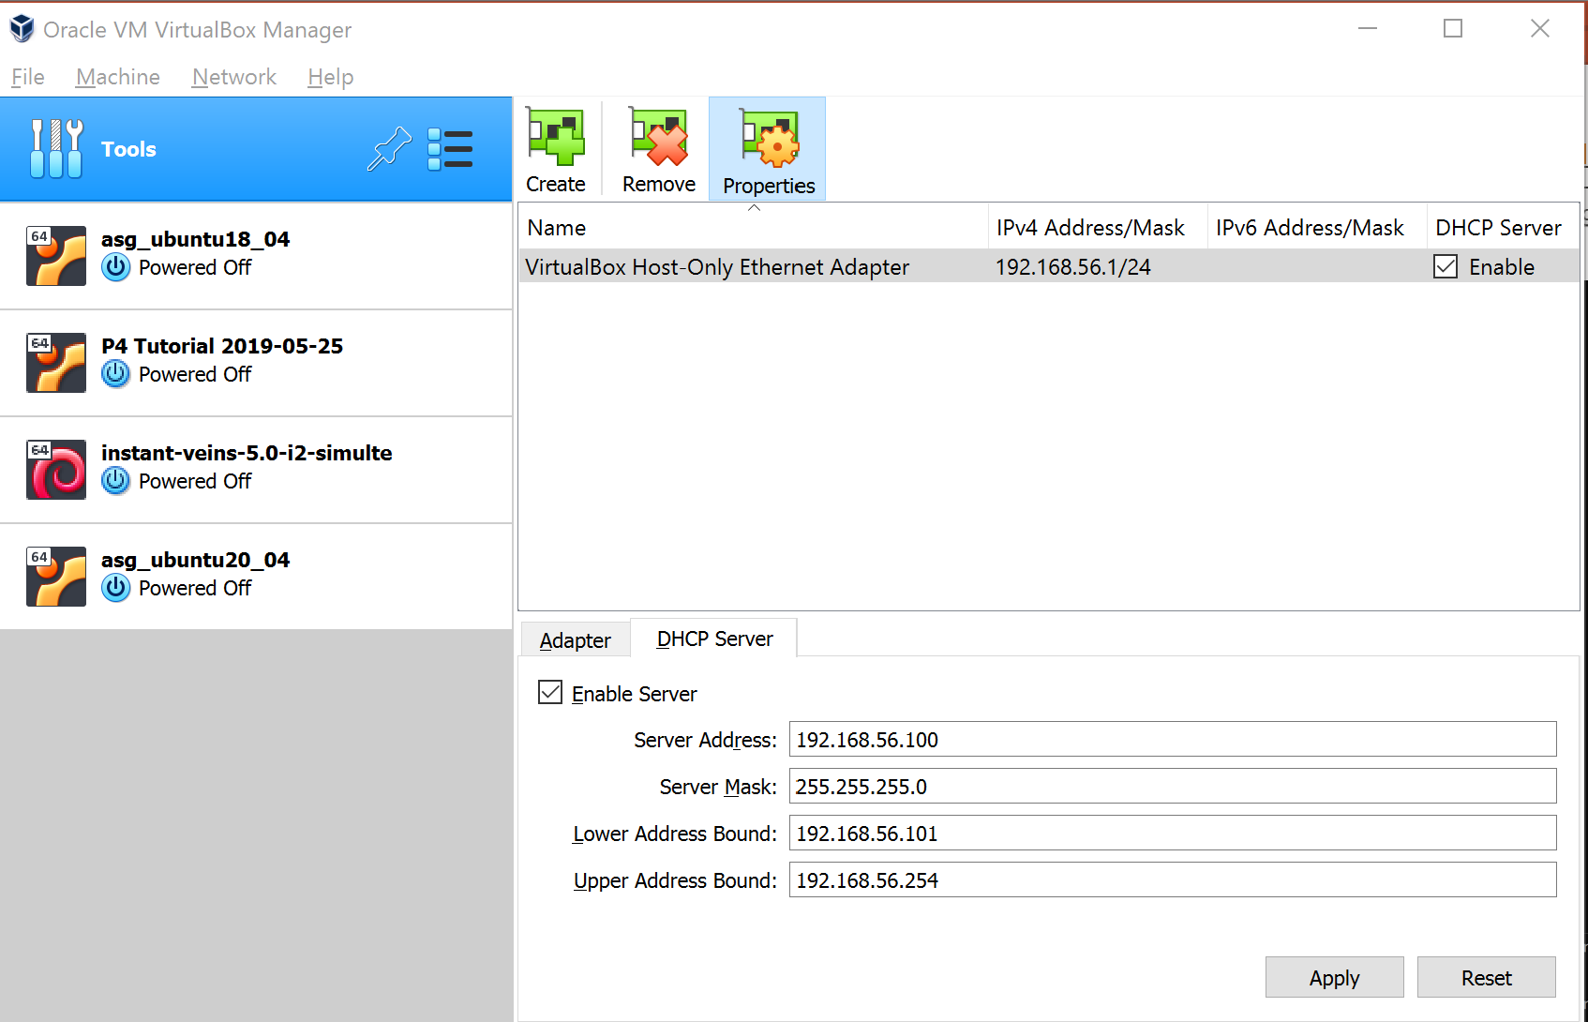
Changing Properties of Host-Only Network
You can also click on the Tools and select Networks and modify the properties of the n/w we created

Slide 14
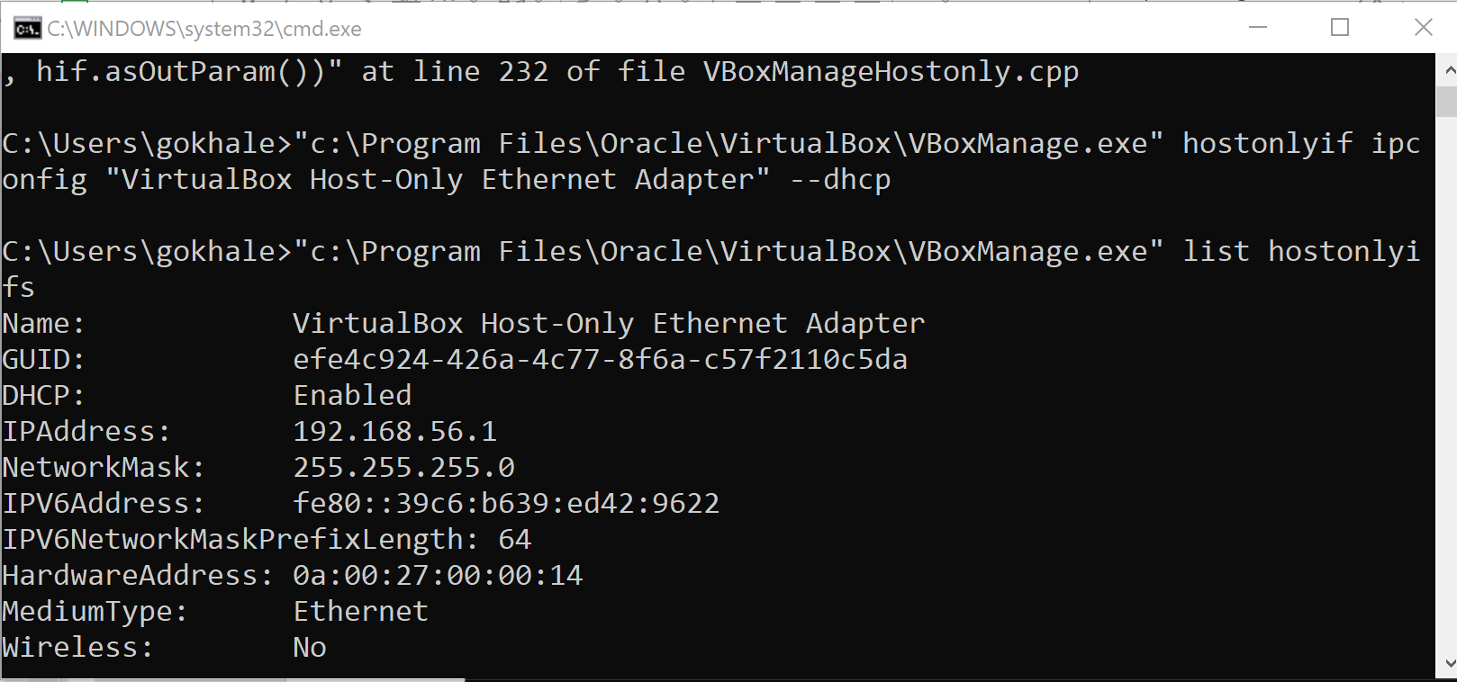
Listing Host-Only Interfaces
Here I made sure that the DHCP is enabled for the host only network just created
I also listed it via VBoxManage

Slide 15
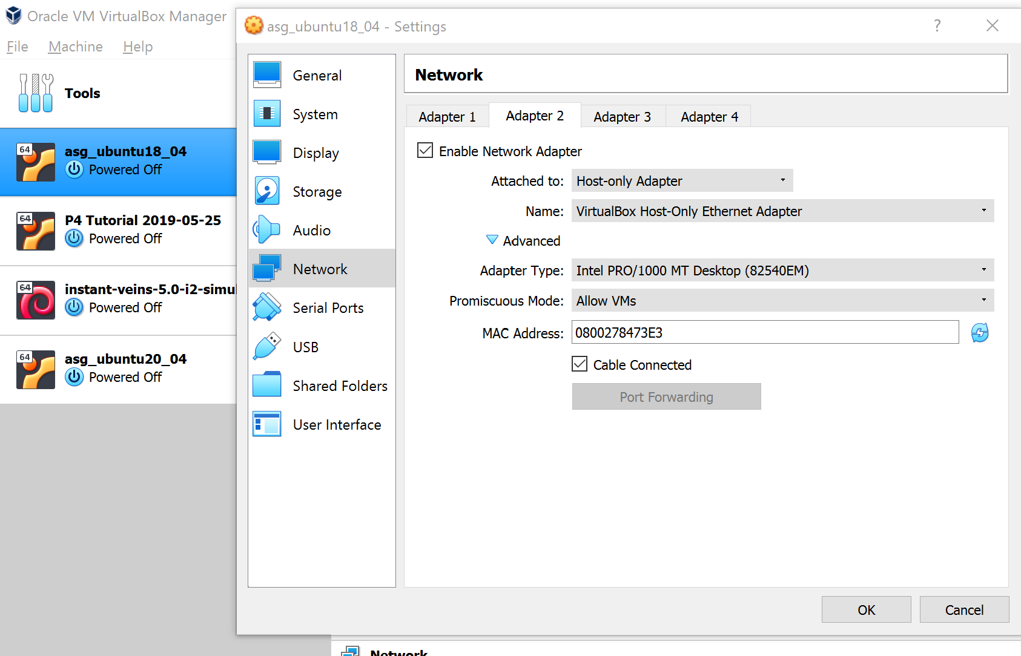
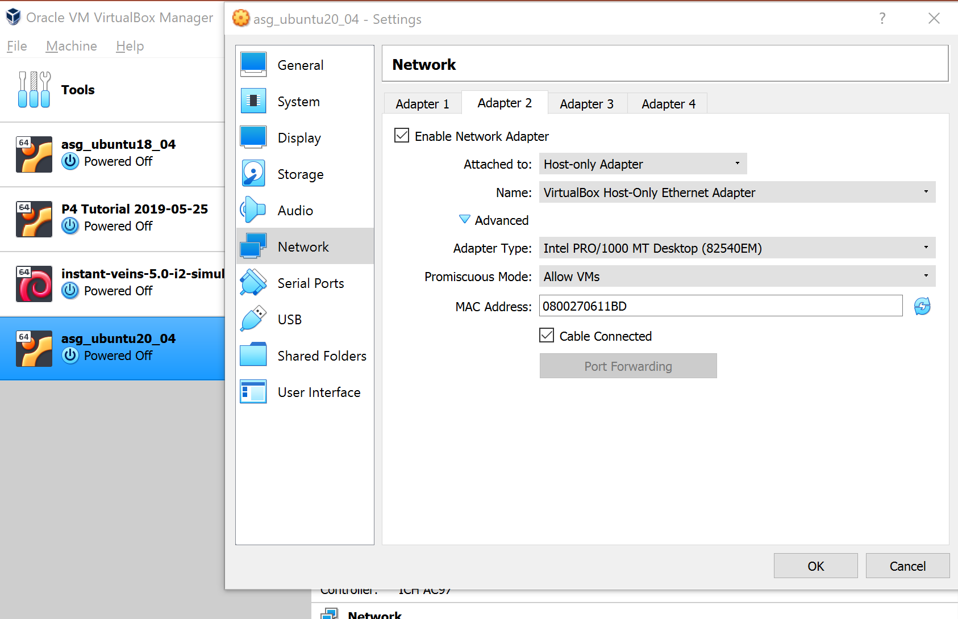
Adding Host-Only Adapters to VMs
For both VMs, we choose the host only network that we just created as their Adapter #2
See the settings in the advanced tab

Slide 16
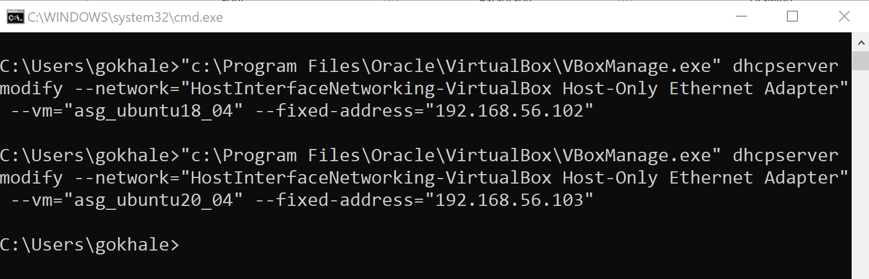
Setting Fixed IP Addresses in Host-Only Network
I assigned 192.168.56.102 to VM1 and 192.168.56.103 to VM2
However, I will be using the NAT Network IP addresses for operations

Slide 17
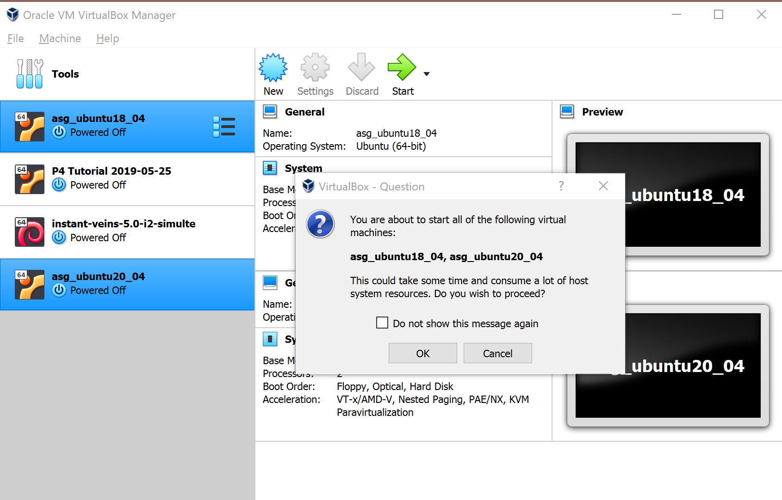
Starting the Two VMs
Select the two VMs and click the Start button on the top

Slide 18
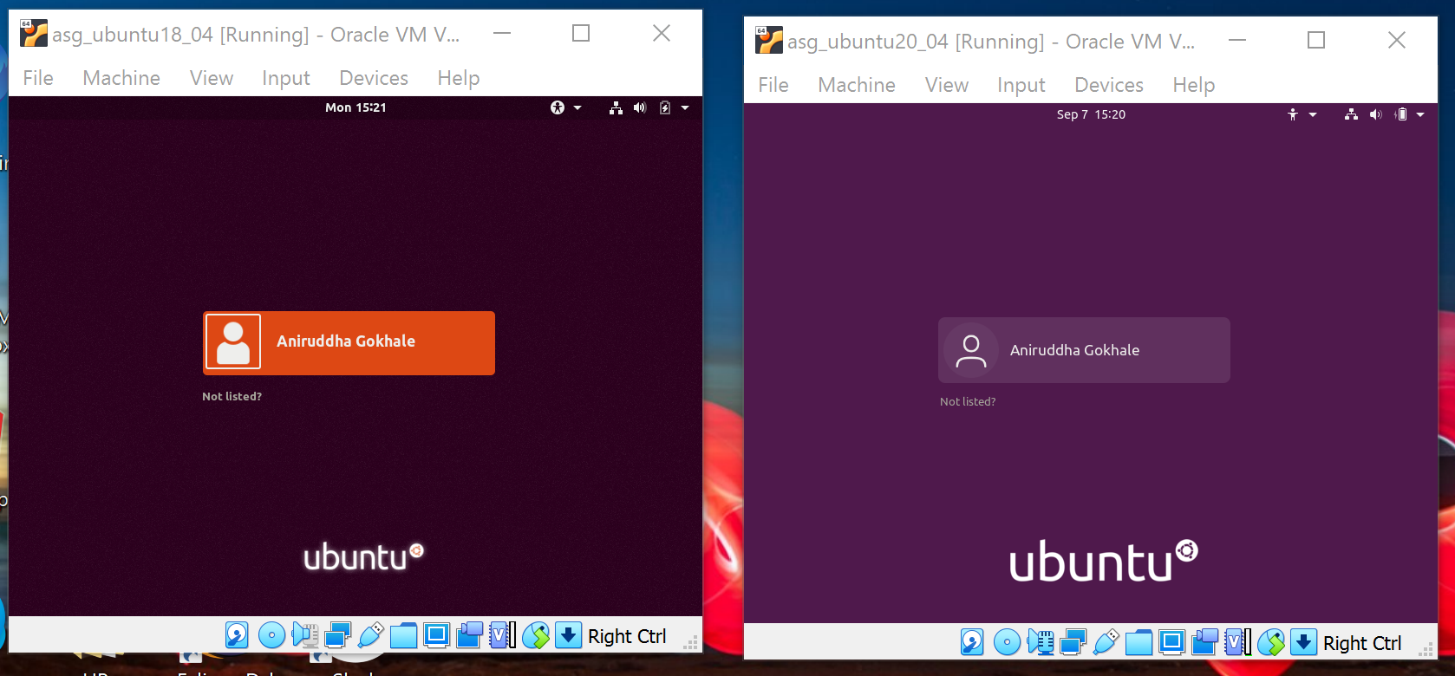
VMs After Boot Up

Slide 19
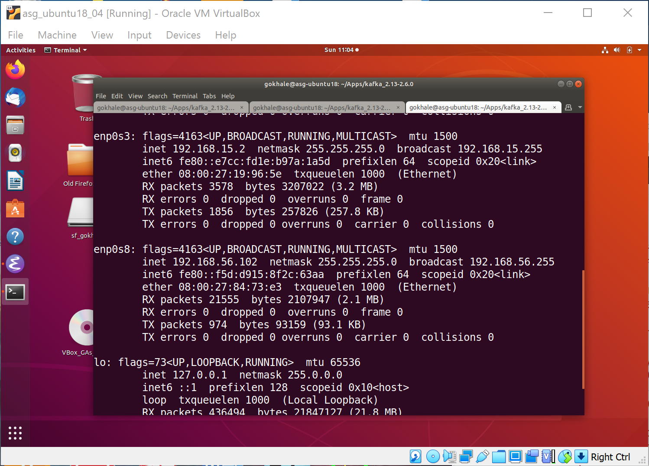
ifconfig Output on VM1
NAT network IP address
Host-only network IP address

Slide 20
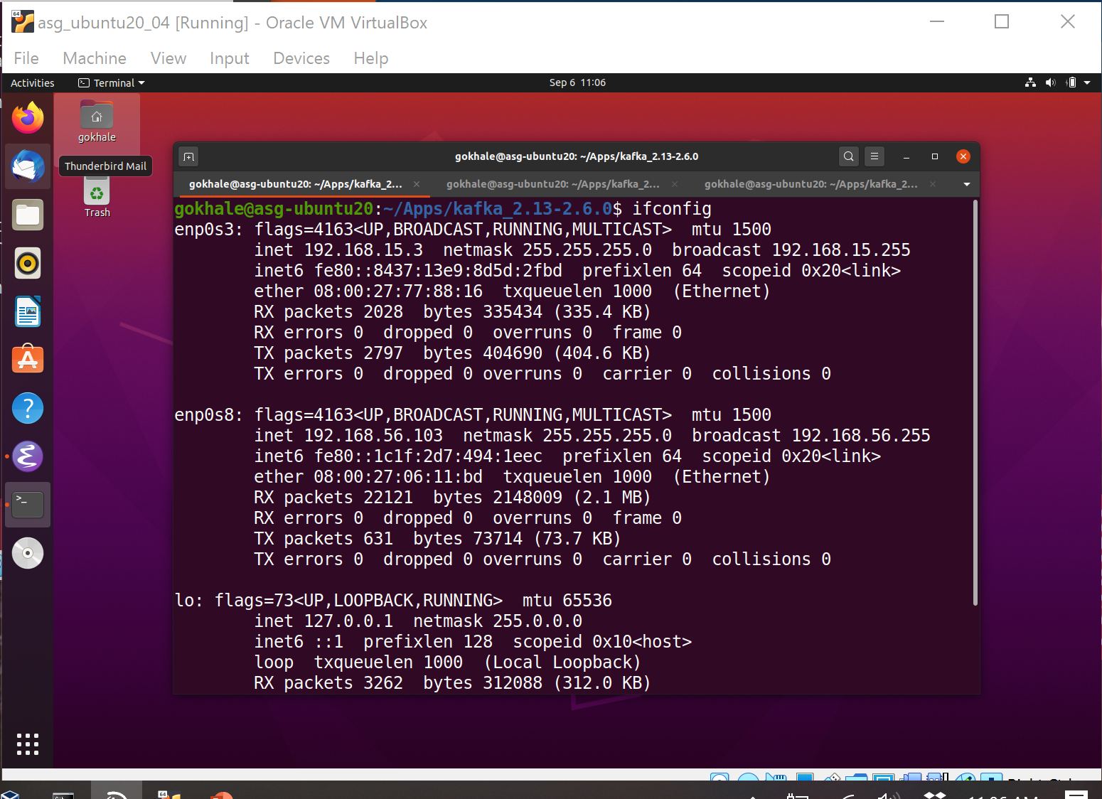
ifconfig Output on VM2
NAT network IP address
Host-only network IP address

Slide 21
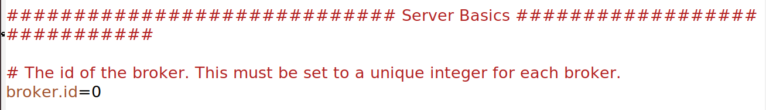
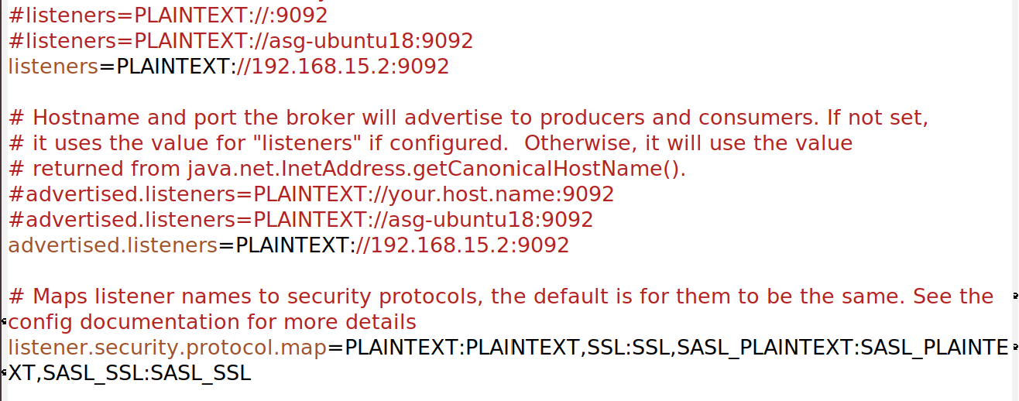
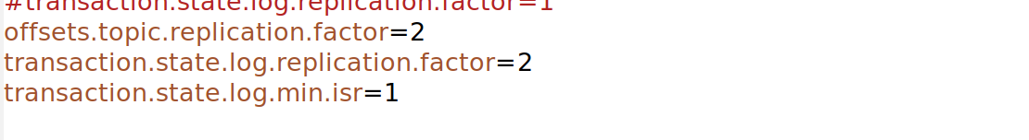
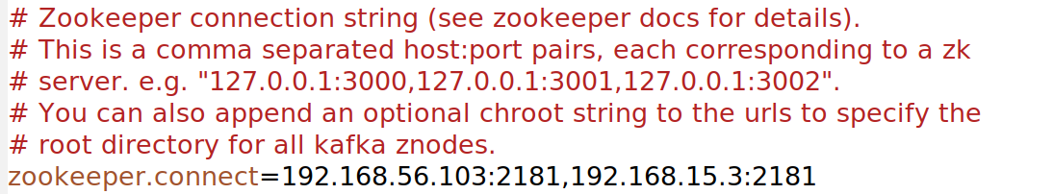
config/server.properties on VM1
Set broker id = 0
Our NAT network IP address
Our NAT network IP address
Uncomment this line about security
Replication factor
To reach the zookeeper

Slide 22
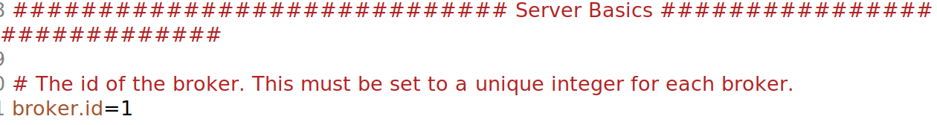
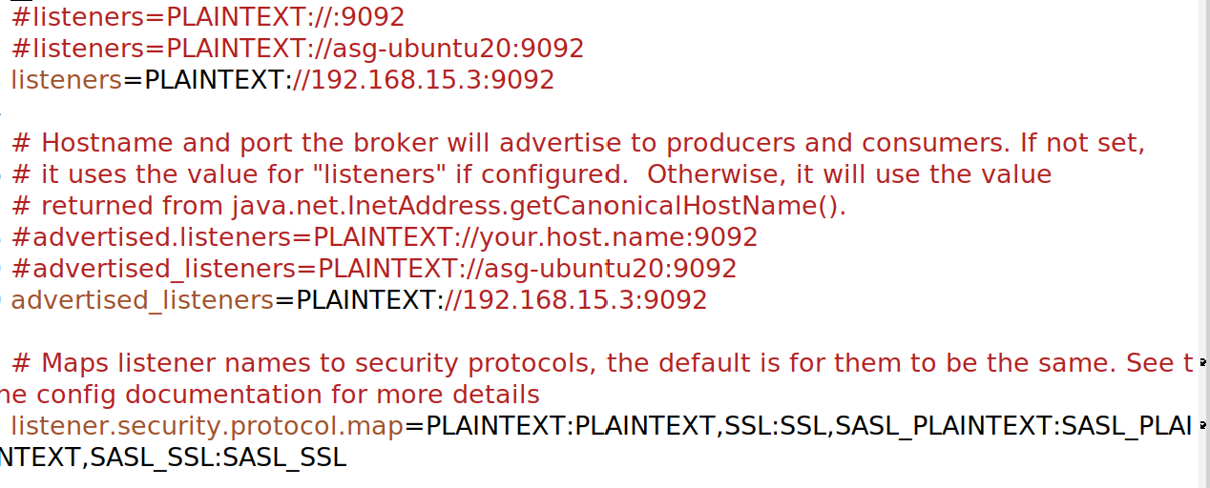
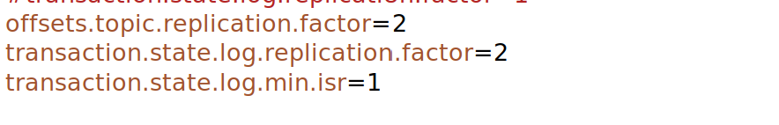
config/server.properties on VM2
Set broker id = 1
Our NAT network IP address
Our NAT network IP address
Uncomment this line about security
Replication factor
To reach the zookeeper

Slide 23
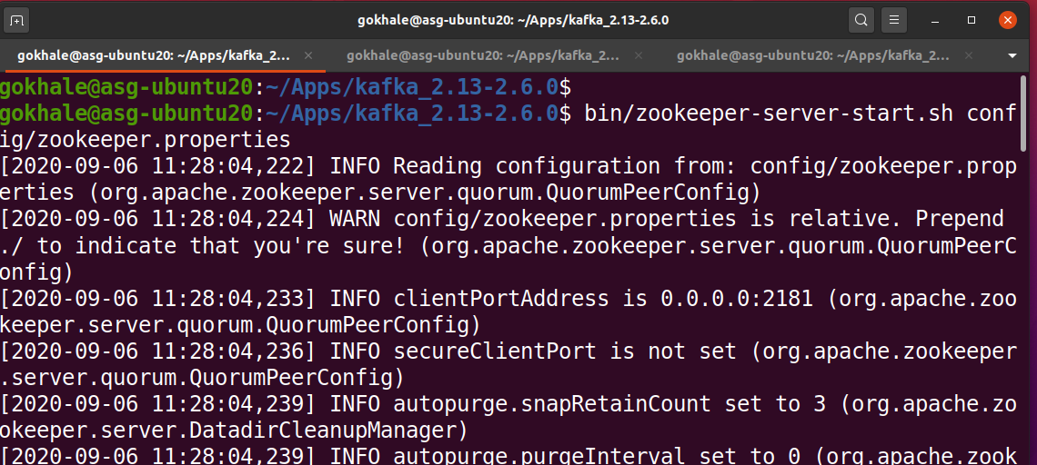
Starting Zookeeper on VM2
Start zookeeper as follows:
bin/zookeeper-server-start.sh config/zookeeper.properties

Slide 24
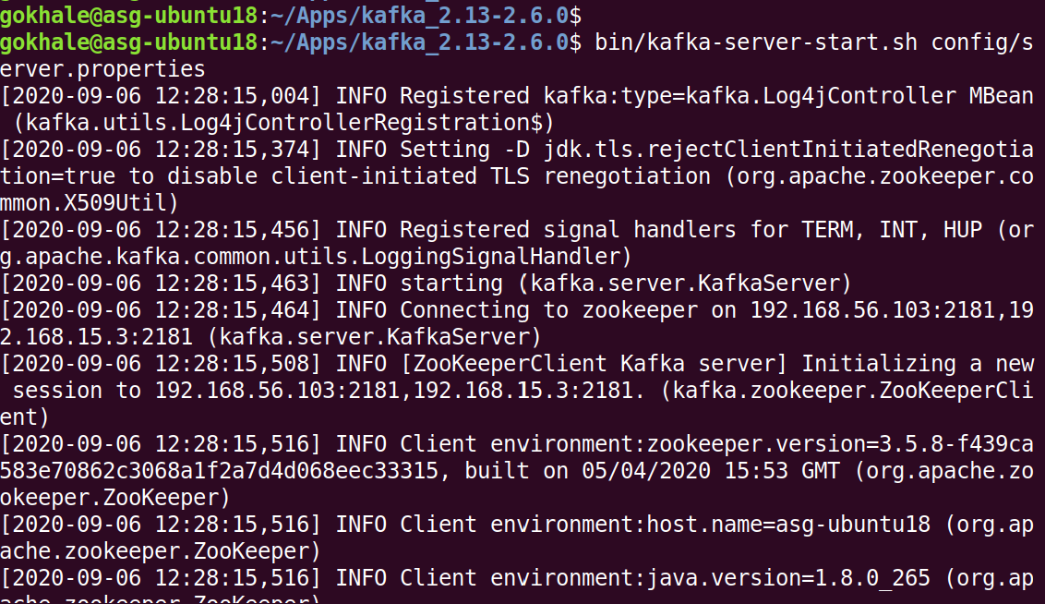
Starting Server1 on VM1
Start server 1 on VM1 as follows:
bin/kafka-server-start.sh config/server.properties

Slide 25
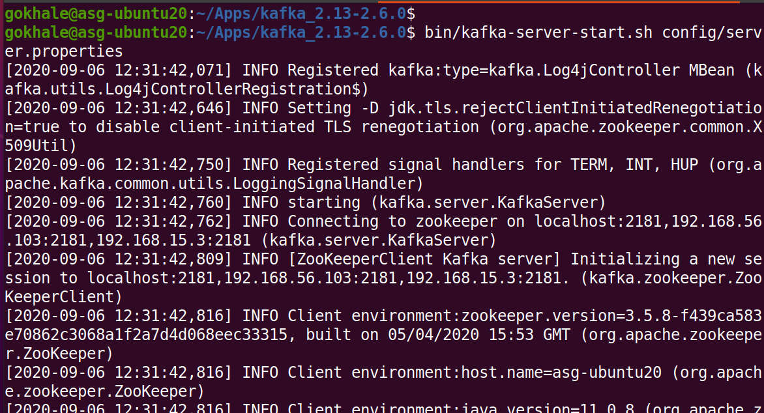
Starting Server2 on VM2
Start server 2 on VM2 as follows:
bin/kafka-server-start.sh config/server.properties

Slide 26
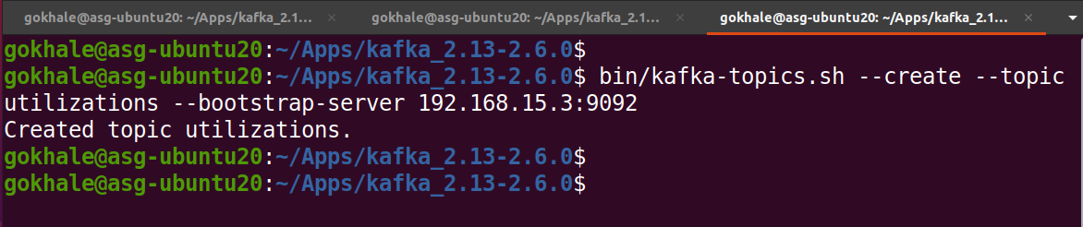
Creating Topic on a VM
We choose to create our utilization topic on VM2 as follows:
bin/kafka-topics.sh --create --topic utilizations --bootstrap-server 192.168.15.3:9092

Slide 27
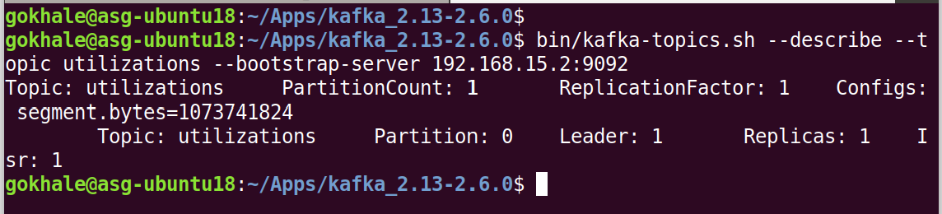
Viewing Topic Properties on Either Kafka Server
Currently we have disabled web-based dashboard to ZooKeeper so it is hard to know who is the leader server is
We can query either server but some time needs to pass so all replicas are aware of the topics
Here we view the properties of our created topic by querying Kafka server on:
bin/kafka-topics.sh --describe --topic utilizations --bootstrap-server 192.168.15.2:9092
OR
bin/kafka-topics.sh --describe --topic utilizations --bootstrap-server 192.168.15.3:9092

Slide 28
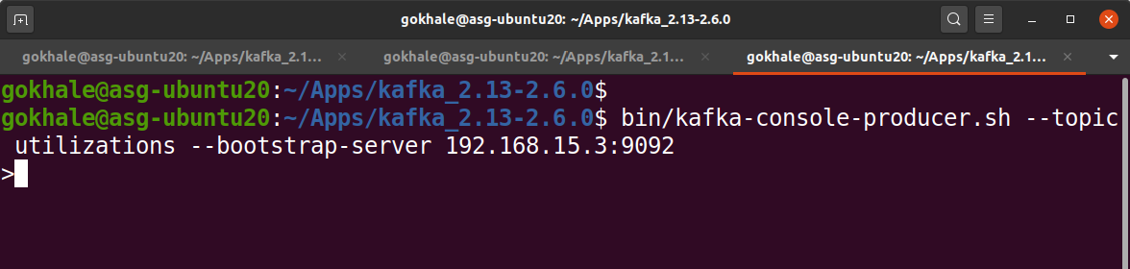
Starting Producer (Console)
Here we will start a producer via command line (say on VM2)
bin/kafka-console-producer.sh --topic utilizations --bootstrap-server 192.168.15.3:9092
We will copy paste some output of the “top” command in the shell

Slide 29
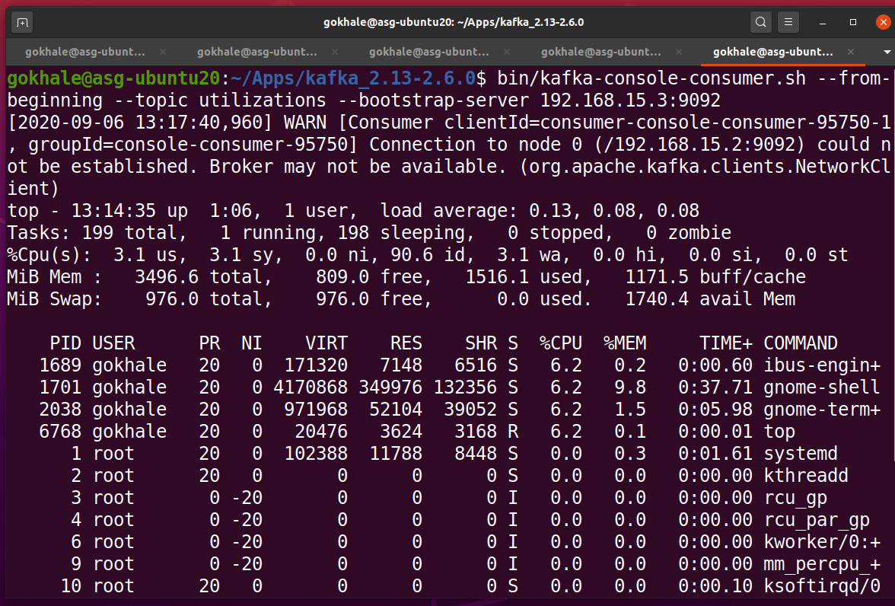
Starting Consumer (Console)
Here we will start a consumer via command line (say on VM1 or VM2)
bin/kafka-console-consumer.sh --topic utilizations --from-beginning --bootstrap-server 192.168.15.3:9092

Slide 30
Python-based Producer/Consumer
Sample code contains a producer and consumer that use the Kafka Python streaming APIs
Producer takes input from the Linux “top” command, encodes it as a value of the topic “utilizations” and sends it to Kafka
Consumer binds to the Kafka cluster, subscribes to the “utilizations” topic and reads every new incoming record and prints the contents
In the assignment you will need to take the incoming key-value pair and dump it into a database like Apache CouchDB.

